Slide 1
Employee Turnover Analysis using Excel
STUDENT NAME : ANELIES JENISHYA CHRISTY S
REGISTER NO : 312210678
DEPARTMENT : B.COM (GENERAL)
COLLEGE : SRM ARTS AND SCIENCE COLLEGE

Slide 2
PROJECT TITLE
Employee Turnover Analysis using Excel

Slide 3


AGENDA
Problem Statement
Project Overview
End Users
Our Solution and Proposition
Dataset Description
Modelling Approach
Results and Discussion
Conclusion
3/21/2024 Annual Review

Slide 4

PROBLEM STATEMENT
To understand and Mitigate Employee Turnover
The analyse the distribution of performance scores across different departments categorized by employee type (Contract, Start date, Quarters, End date) over multiple years. The performance scores are segmented by gender, employee type and department.

Slide 5

PROJECT OVERVIEW
The Production department has the highest concentration of performance scores, particularly among Full-Time employees.IT/IS also shows a notable concentration of scores, primarily for Full-Time employees. There are fewer performance scores recorded for Contract and Part-Time employees across all departments. The count of performance scores appears relatively stable over time across most departments, with some minor fluctuations.

Slide 6

WHO ARE THE END USERS?
The end users of the information in the bar graph are likely to include:
Human Resources (HR) Managers
Department Heads
Executives and Leadership
Diversity and Inclusion Officers
Data Analysts

Slide 7

OUR SOLUTION AND ITS VALUE PROPOSITION
OUR SOLUTION AND ITS V ALUE PROPOSITION IS AS FOLLOWS:
Data-Driven Decision-Making
Enhanced Performance Management
Promoting Equity and Inclusion
Historical Insights and Trend Analysis
Resource Optimization
our solution delivers actionable insights that help organizations improve overall performance, promote fairness, and optimize resource utilization, ultimately driving better business outcomes.

Slide 8
Dataset Description
Employees:
Employee ID
Gender Code
Employee type
Departments:
Department ID
Department Name
Performance Score:
Performance Score ID
Score Date
Year
Employees Details
Employee ID
Start Date
End Date

Slide 9

THE "WOW" IN OUR SOLUTION
=J2+K2+L2+other components,
=J2+K2+L2
=F2-(G2+H2+I2)
=IFS( Z * 8 >= 5 "VERY HIGH", Z * 8 >= 4 , "HI GH" Z * 8 >= 3 "MED", TRUE, "LOW")
3/21/2024 Annual Review
9

Slide 10
MODELLING
Data Collection:
“Kaggle= Employee Turnover Analysis.
Features Collection:
Performance Score = Numerical Value
Gender Code
Employee Type
Department Type
Start Date
Quarters
End Date
Year
10

Slide 11
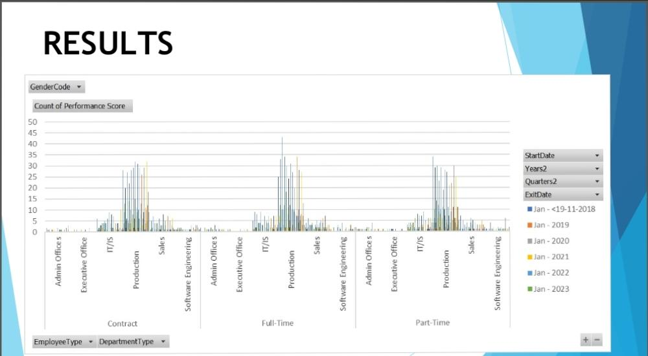
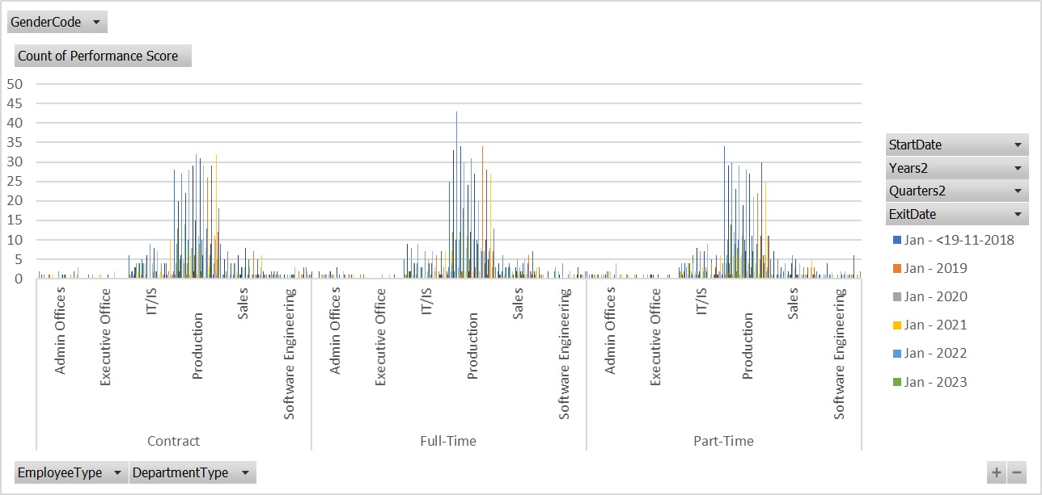
RESULTS
11

Slide 12
conclusion
The bar graph reveals significant insights into the distribution of performance scores across various departments, employee types, and over different years
High Concentration in Production and IT/IS Departments:
The Production and IT/IS departments show the highest concentration of performance scores, particularly among Full-Time employees. This suggests that these departments might have more rigorous or frequent performance evaluations, or that they have a larger workforce compared to other departments.
Limited Performance Scores for Contract and Part-Time Employees:
There are noticeably fewer performance scores recorded for Contract and Part-Time employees across all departments. This could indicate that these employee types undergo less frequent performance evaluations or that fewer of them are employed.
Stable Performance Scores Over Time:
The performance scores across the years appear relatively stable with some fluctuations. This stability suggests consistency in performance evaluation processes, though it also implies that there may not be significant improvements or declines in performance over the observed period.

